Slide 1
Mutations by size, month, and UV
Altering 0.5% (square root transformed) versus (cells)^2 = Divisions

Slide 2
ANCOVA results
Dependent Variable | SQRALT005
N | 54
Multiple R | 0.573
Squared Multiple R | 0.329
Analysis of Variance
Source | Type III SS | df | Mean Squares | F-Ratio | p-Value
MONTH | 15.706 | 1 | 15.706 | 5.796 | 0.020
UV$ | 21.790 | 1 | 21.790 | 8.041 | 0.007
LOG2VOLUME | 6.541 | 1 | 6.541 | 2.414 | 0.127
Error | 135.496 | 50 | 2.710
Least Squares Means
Factor | Level | LS Mean | Standard Error | N
UV$ | No UV | 2.303 | 0.411 | 19.000
UV$ | UV | 3.706 | 0.297 | 35.000

Slide 3
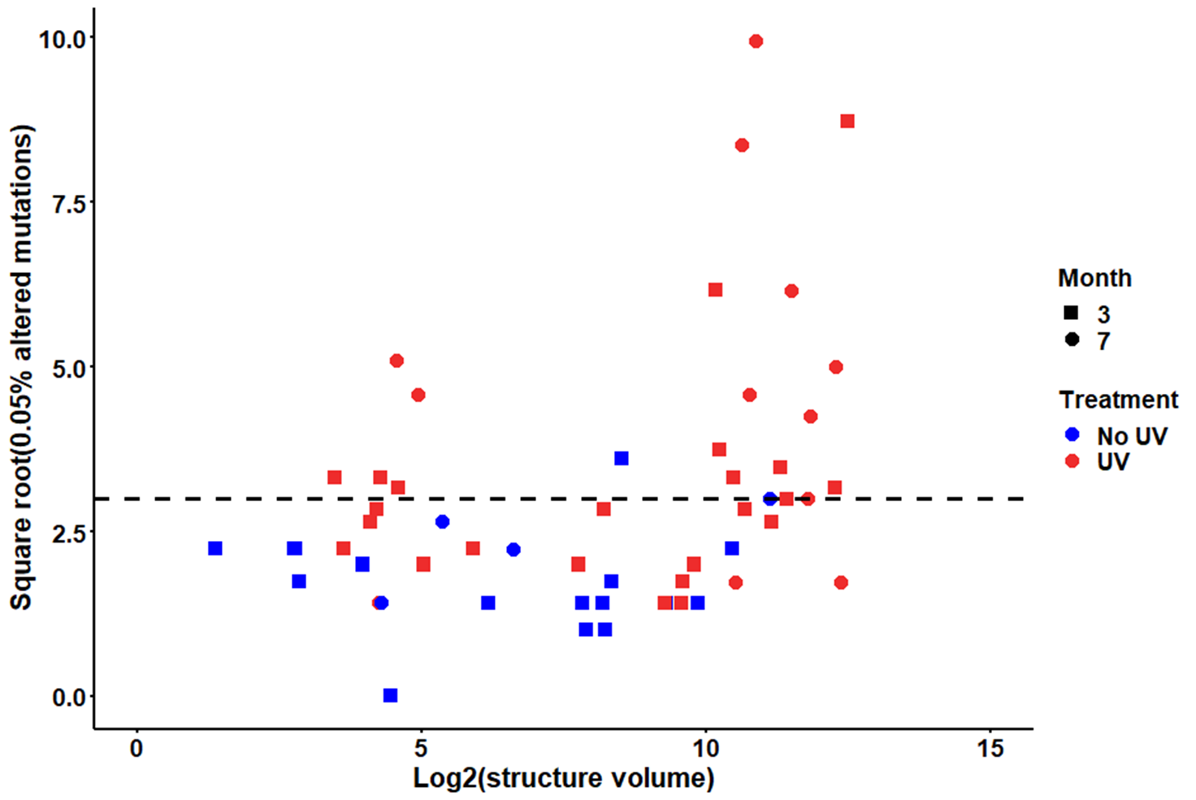

Slide 4
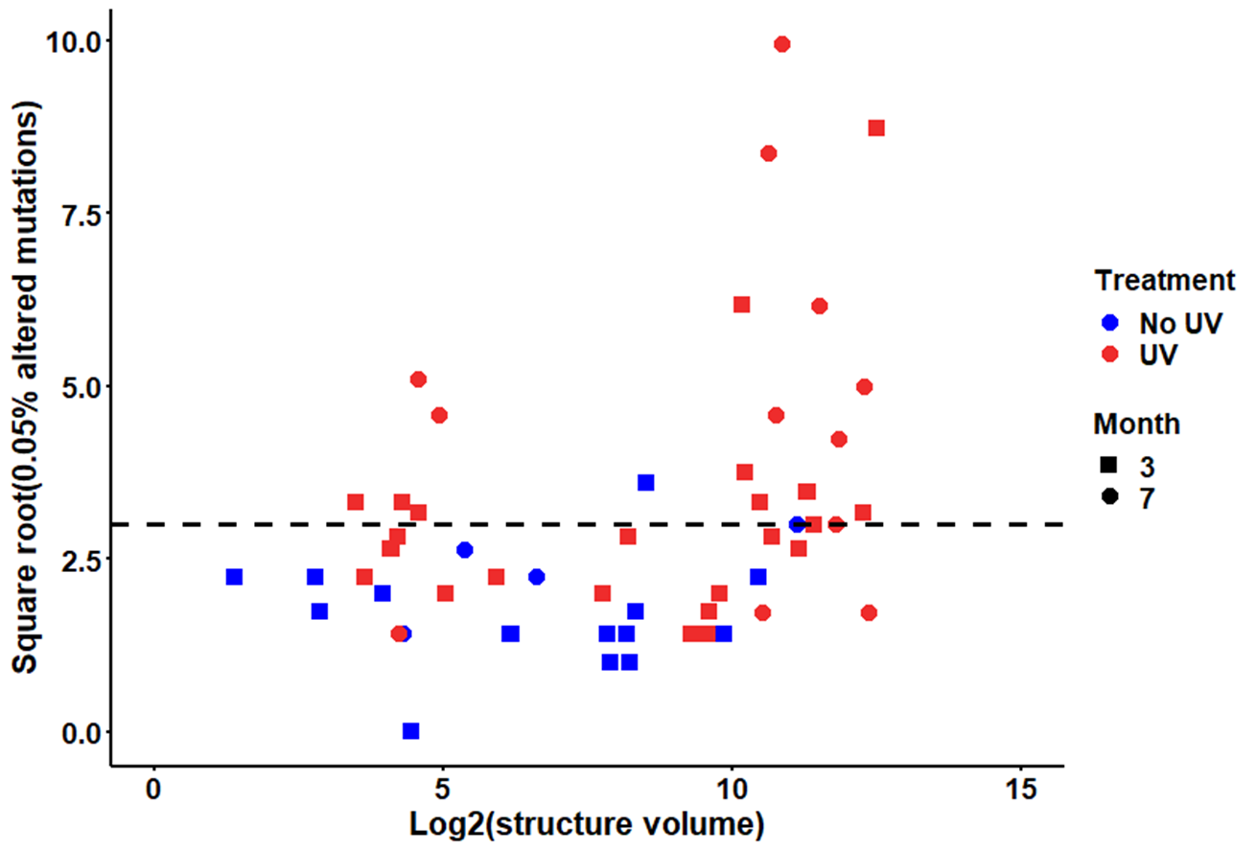

Slide 5
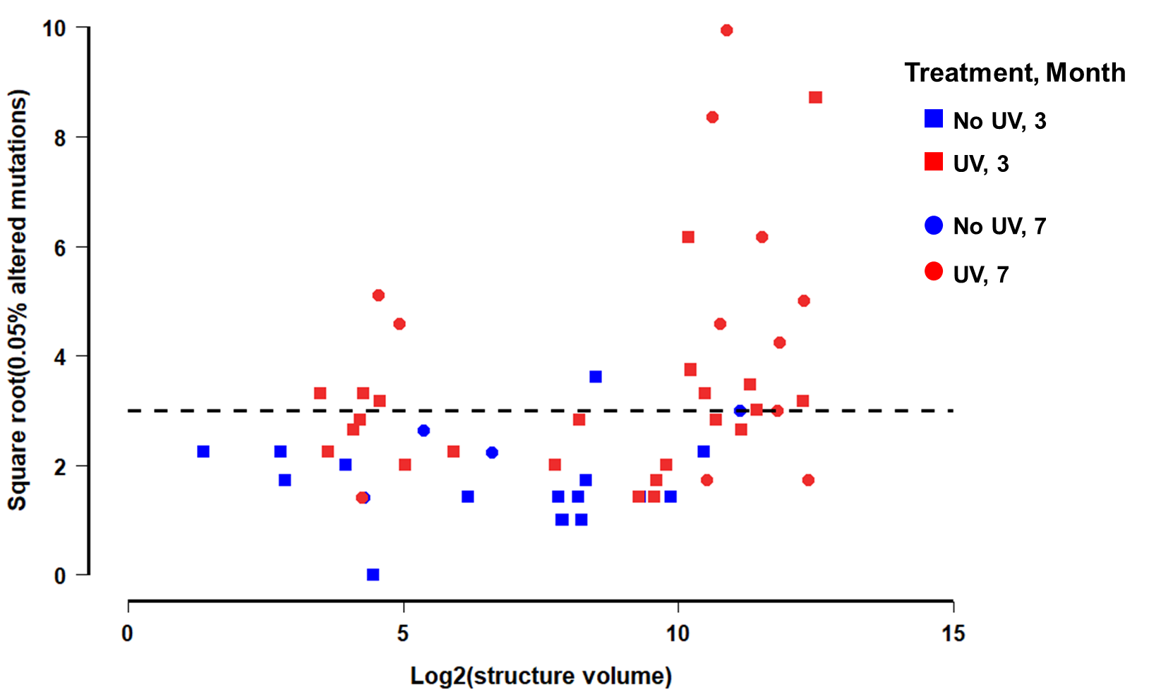

Slide 6
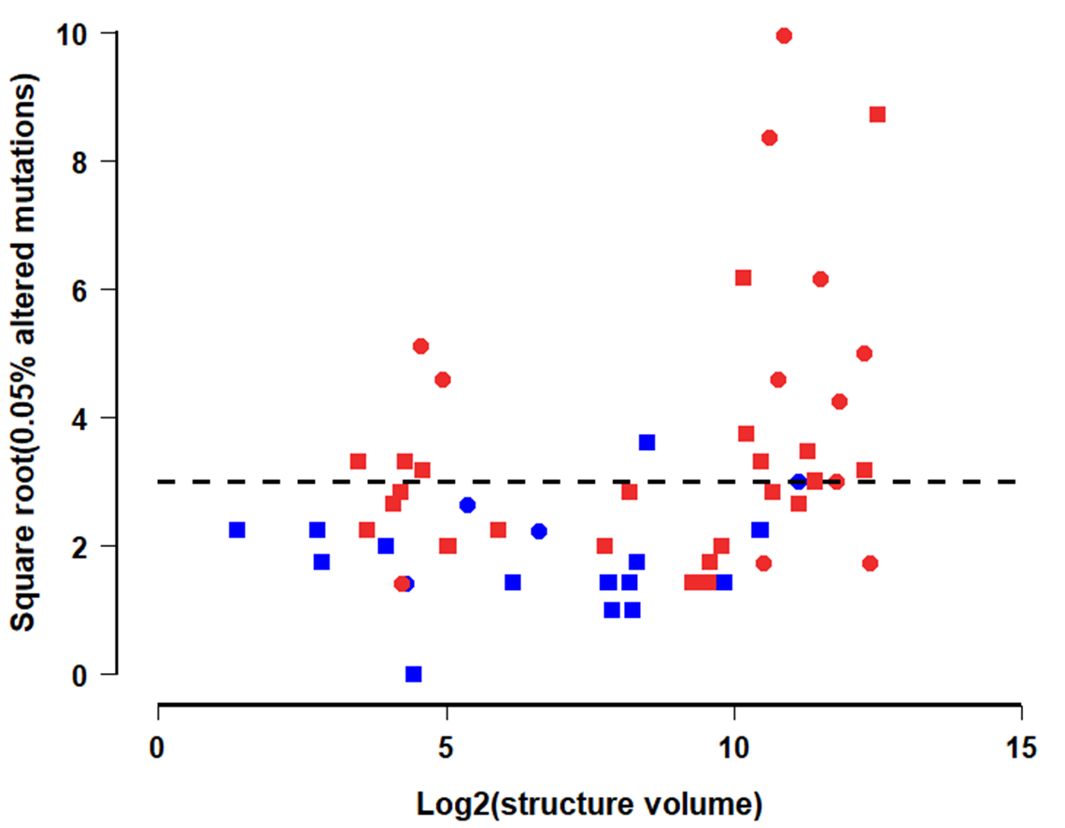
Treatment
No UV
UV
Month
3
7

Slide 7
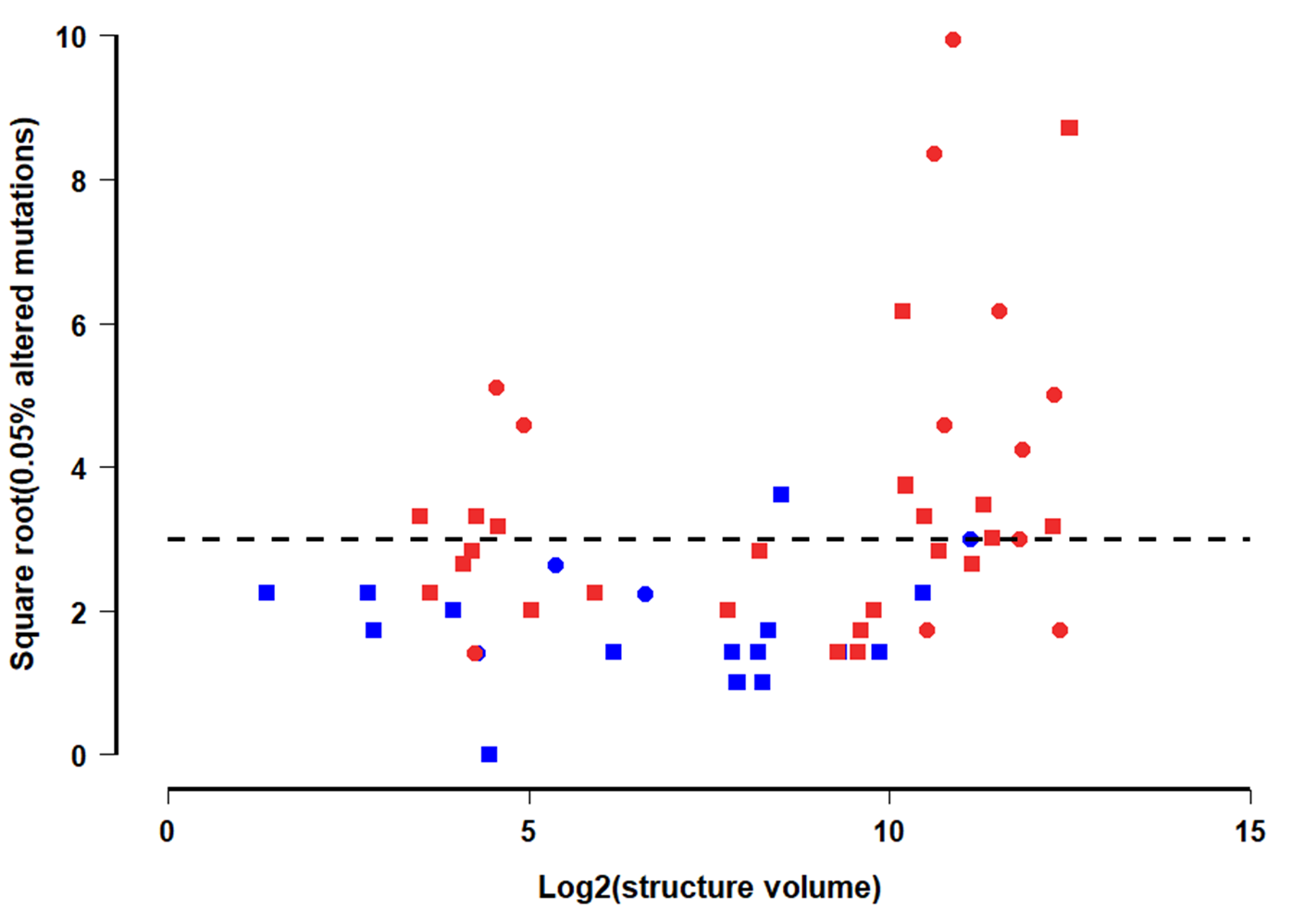
Treatment, Month
No UV, 3
UV, 3
No UV, 7
UV, 7

Slide 8
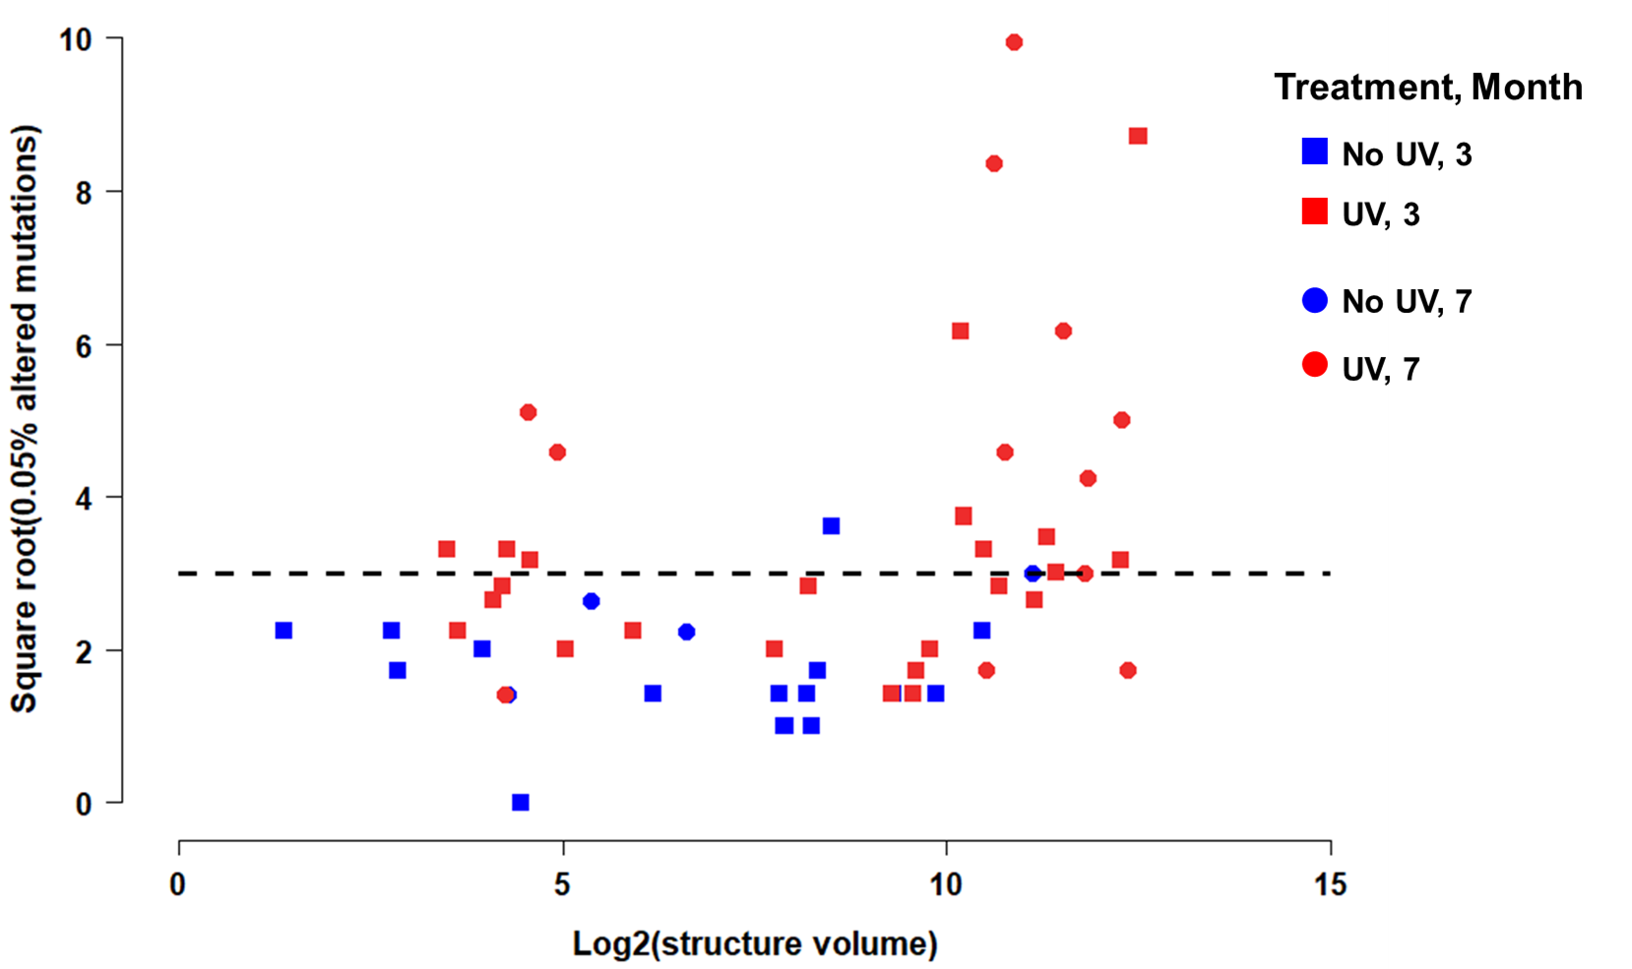

Slide 9
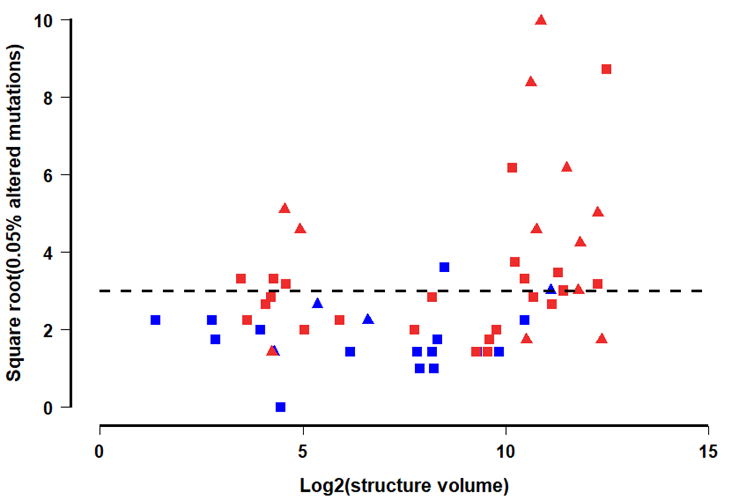
Treatment, Month
No UV, 3
UV, 3
No UV, 7
UV, 7

Slide 10
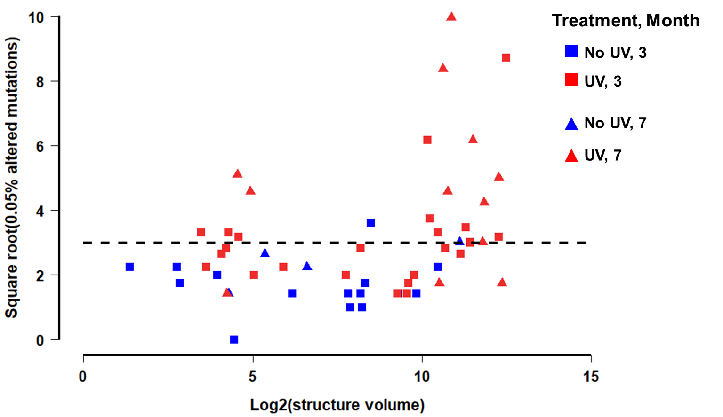

Slide 11
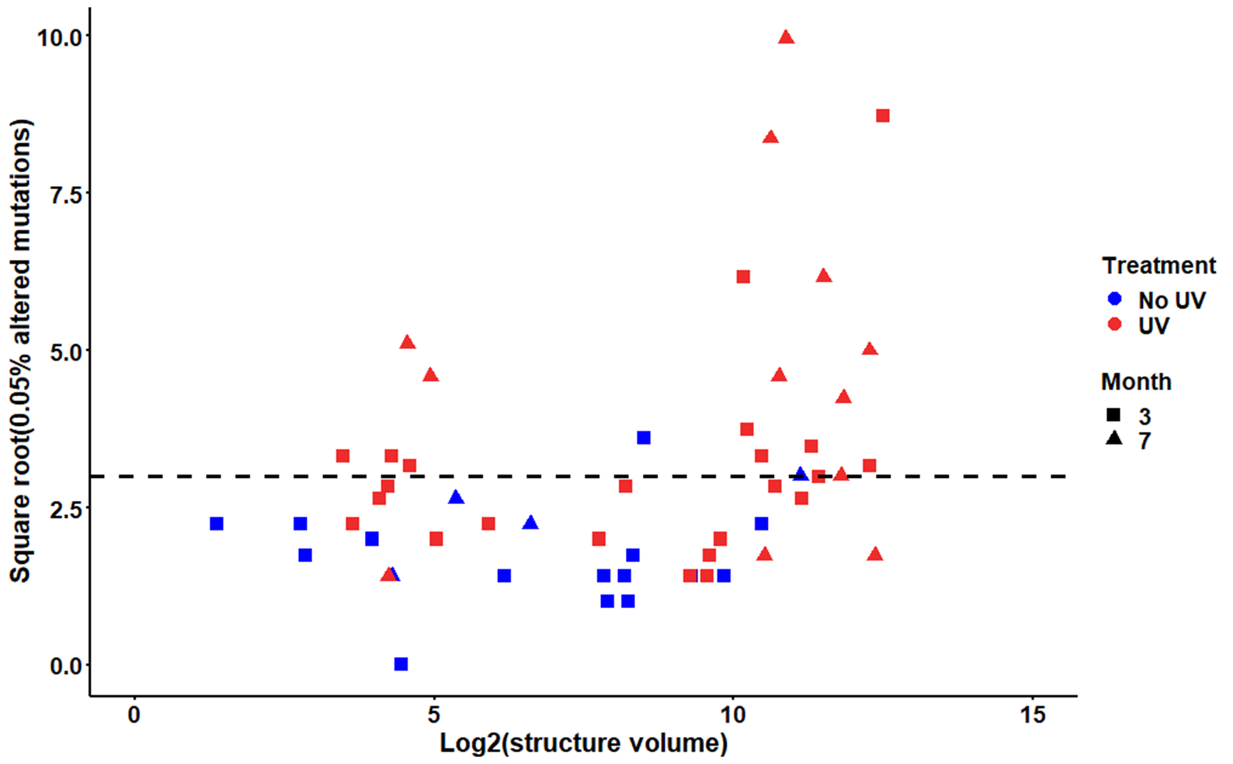

Slide 12
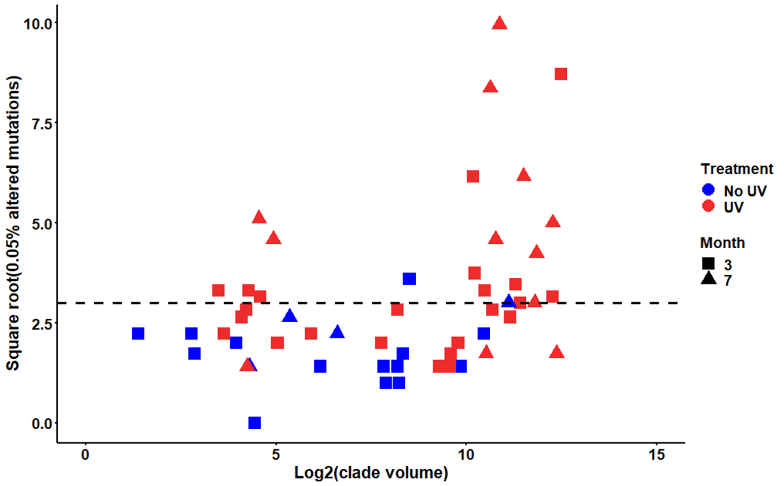

Slide 13
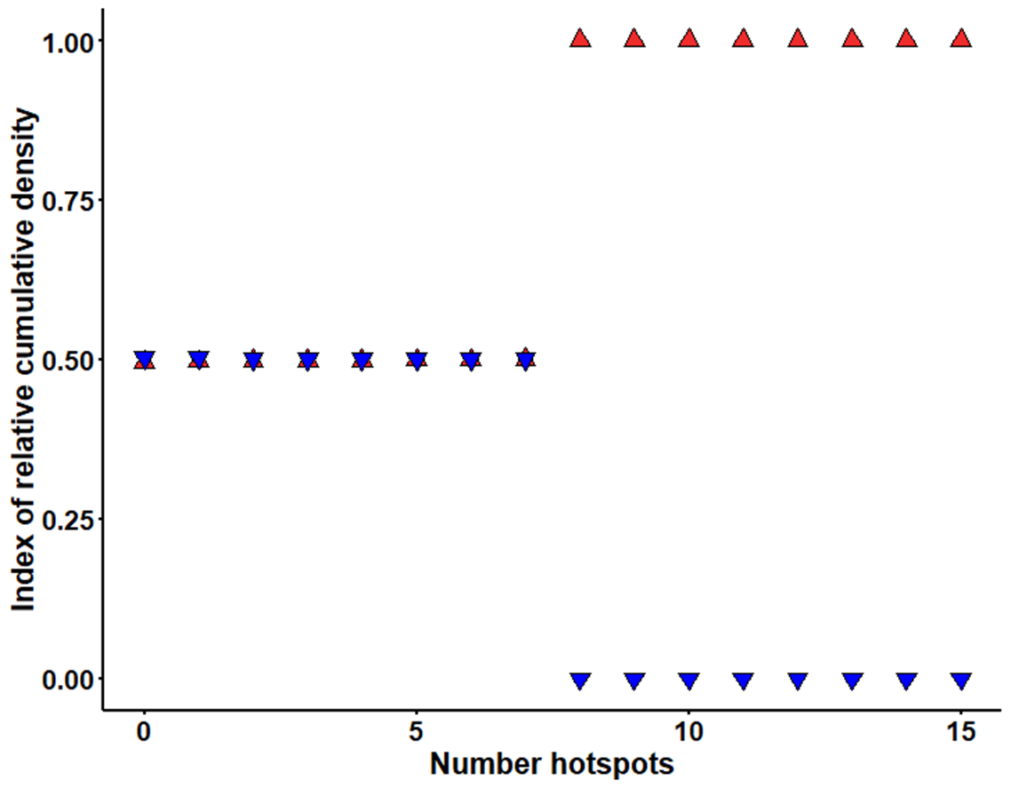
Treatment
No UV
UV

Slide 14
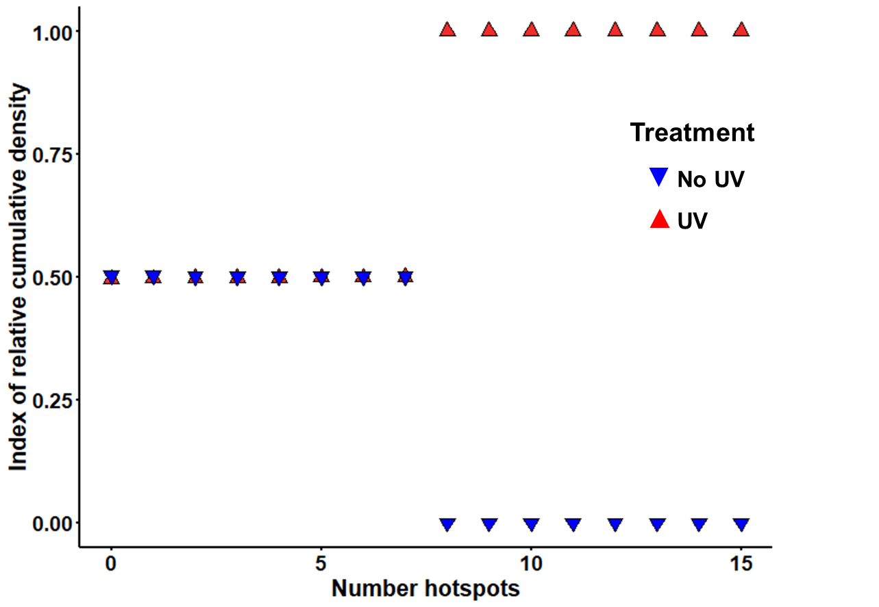

Slide 15
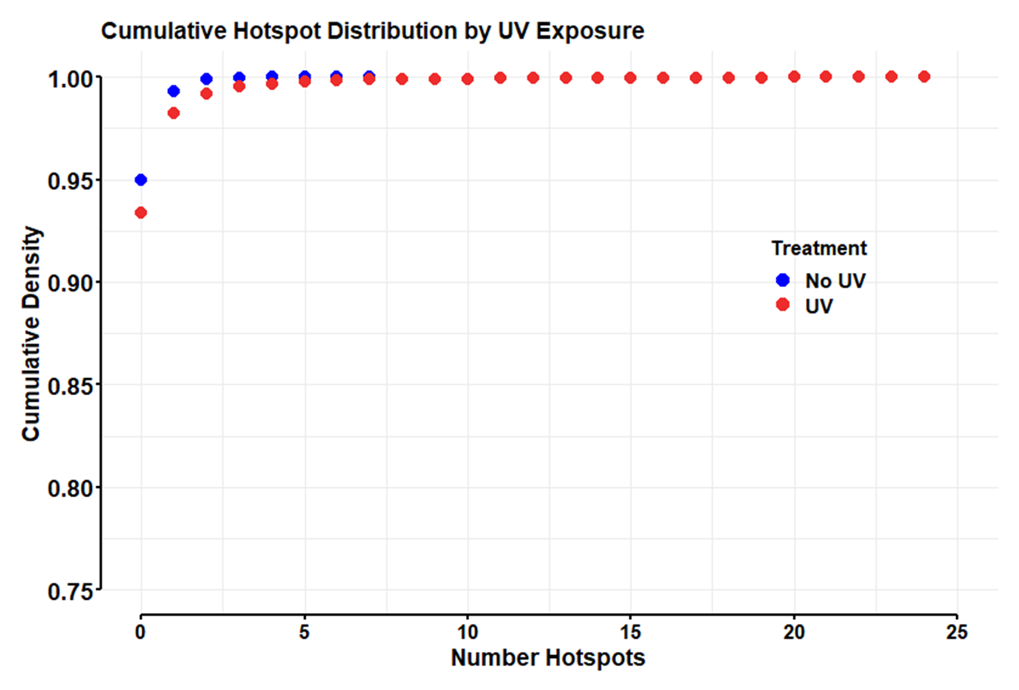

Slide 16
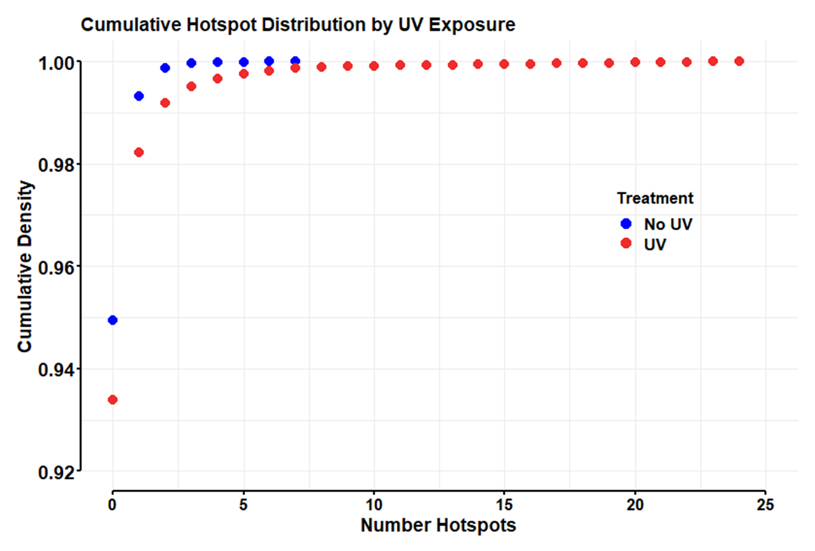

Slide 17
